Slide 1

ELK
Easy Link Keeper
Introduction
Who are we and what is the project that we’ve been working on for the past few weeks?
02. Inventory
What goals did we set for our project, and who focused on what?
03. Development
What did we use for our development, what languages and libraries did we utilize for our project.
04. Demo
How does our application work, and how does it feel? We will give a small demo at the end of this presentation.

Slide 2


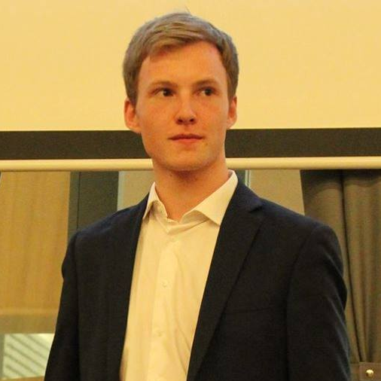
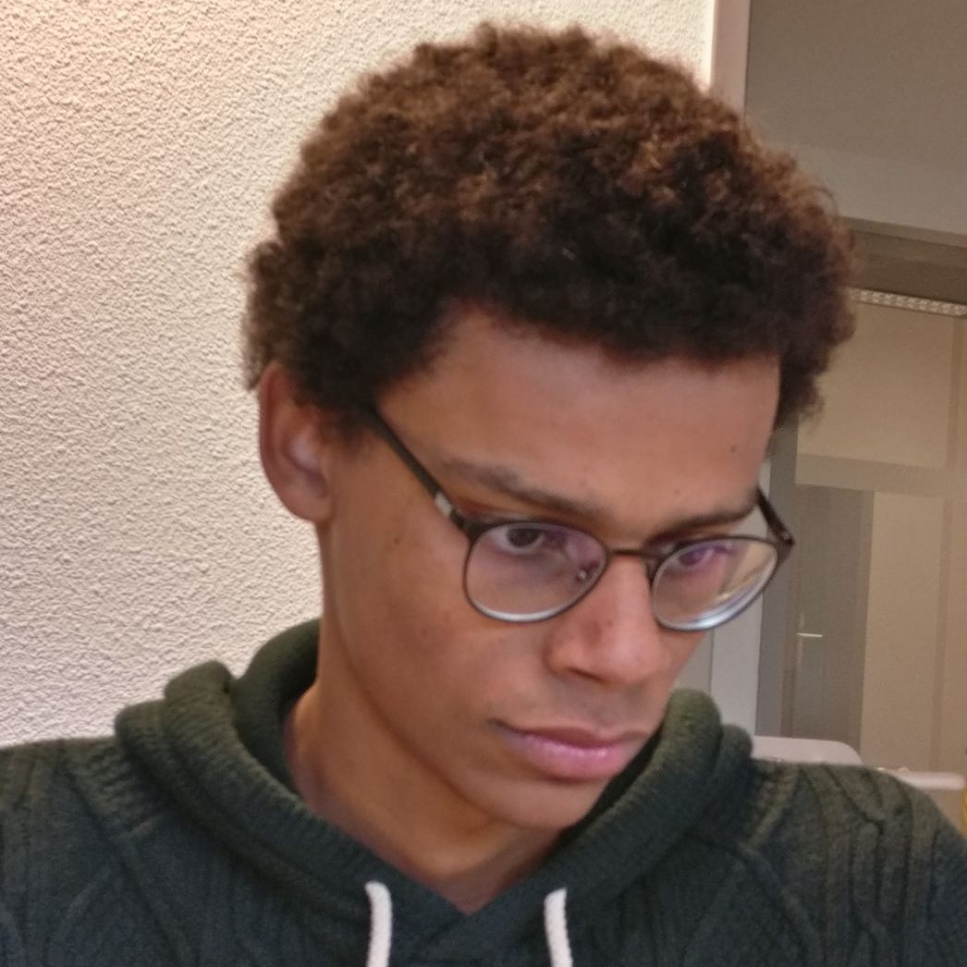


Vince van Noort
Niek Geijtenbeek
Madio Seck
Jort van Gorkum
Tijmen van der Spijk

Slide 3

About Us
A motivated bunch
We’re a group of motivated computer-science students who really wanted a challenge, and we sure got one.
General programming experience, more than just the C#-course.
Eager to learn more, willing to learn several forms of JS for implementation.
Experience with graphics and styling due to a pervious study.
Experience with web-development and various data structures.

Slide 4
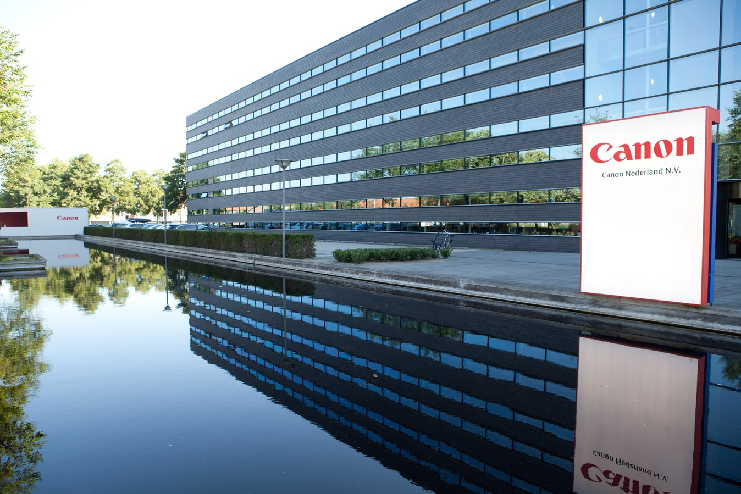
About the assignment
We got our assignment from Canon-Europe
We really wanted to get our own assignment, instead of getting one assigned. So even prior to the project starting we decided to hunt for our own assignment and ended with the one that Canon was willing to provide because it’d be challenging but with our prior experience the assignment was doable.

Slide 5
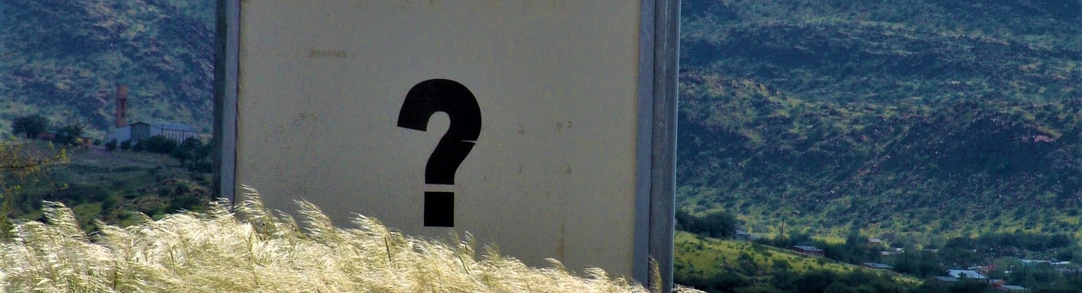
THEY NEEDED IT FAST
They are rolling out a new set of trainings worldwide and they wanted to update their paper version in a record time.
FINE TUNED TO THEIR NEEDS
They have a strong vision in regards to the look and feel of their program, with a project like this they would keep control.
ORGANIZED
The paper version is a mess, it requires a lot of time to set up and explain. With an web-application you can take it on the go, everywhere!

Slide 6
Providing structure
Being able to look into the structure of a company and assign multiple proposals.
Stop losing information
Neatly storing all information that belongs to a company in a database so you simply can’t lost it as easily as a piece of paper.
All-in-one
Find all the information in one neatly organized package instead of franticly searching trough a stack of paper.
Getting the deal
Providing some scoring systems that’s able to guide the user into getting the end goal in sight: the deal.

Slide 7
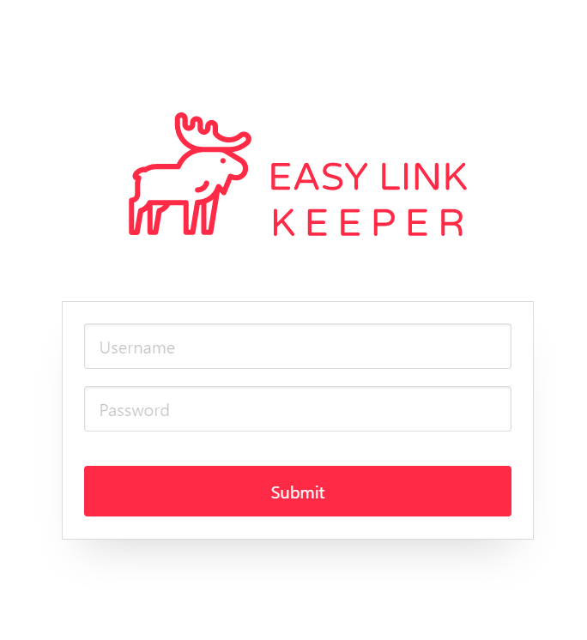
NEATLY PACKED
No longer there’s a need for users to tumble trough pages of paper forms to look for specific details on company, you can find all the information you need right here in one neat overview.
ON THE GO
Easily accessible with just a username and password, there’s no need to bring stacks of printed paper with you just to get your point across!
LIGHTNING FAST EDITS
No longer will your data become unreadable once you’ve tried to edit existing data, no need to strikethrough your previous findings if editing them is just one click away.
NO NEED TO LOSE YOUR PROGRESS
With the pervious paper version, if you’d lose it you’re done. You can start all over again. But this flaw has been fixed by storing the data inside a database, which is quite frankly much harder to lose!

Slide 8
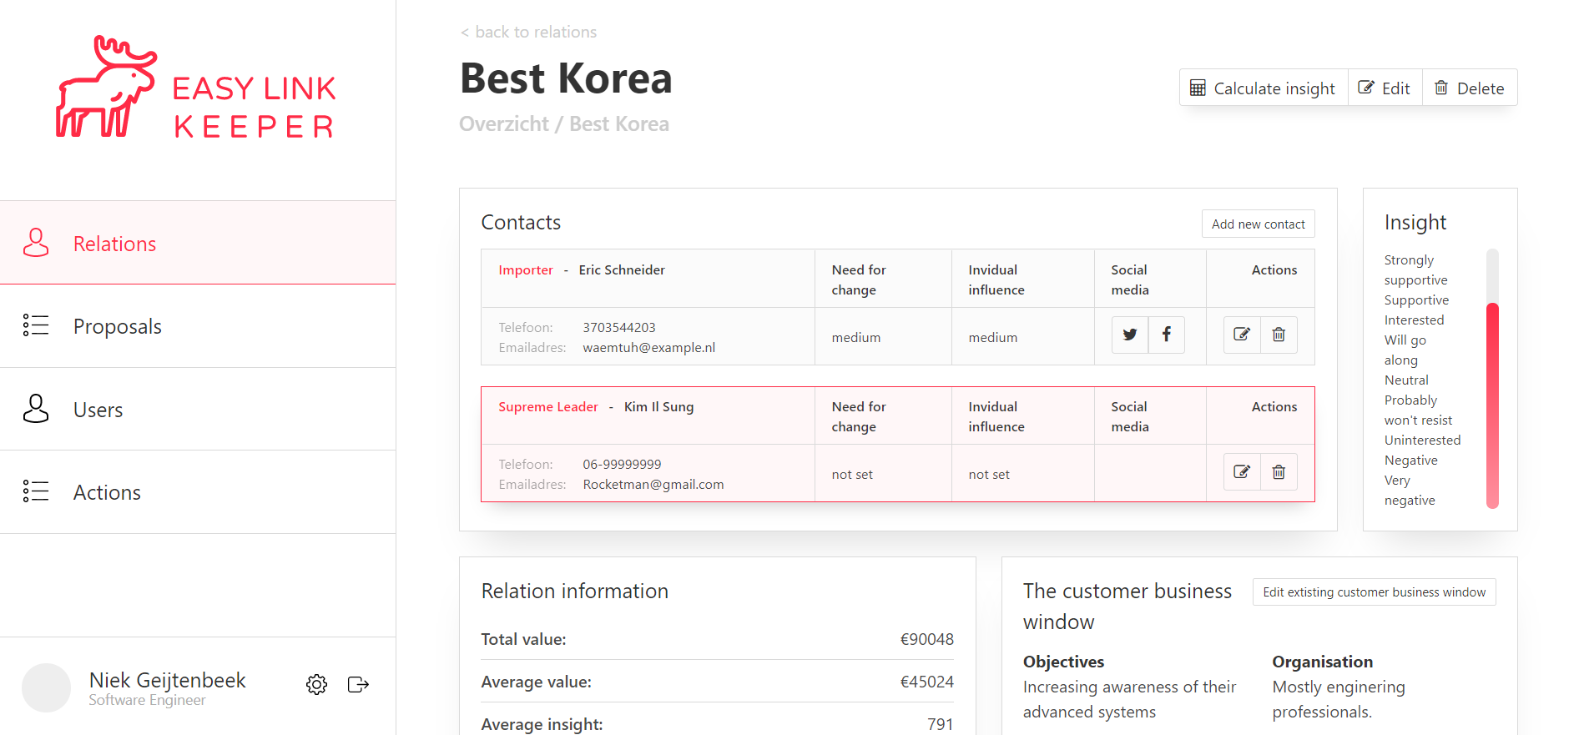
All-in-one
All the information you need in one neat place.
No longer will users franticly search for the notes on a certain company when it’s all neatly and intuitively packed in the right place, right were you expect it to be.

Slide 9




Getting the deal
In the end this is what matters.
We implemented some features to guide the user into getting the deal, mostly the insight and potential formula are the best example
of this.
1,000
Points to score
100%
Insight and potential

Slide 10
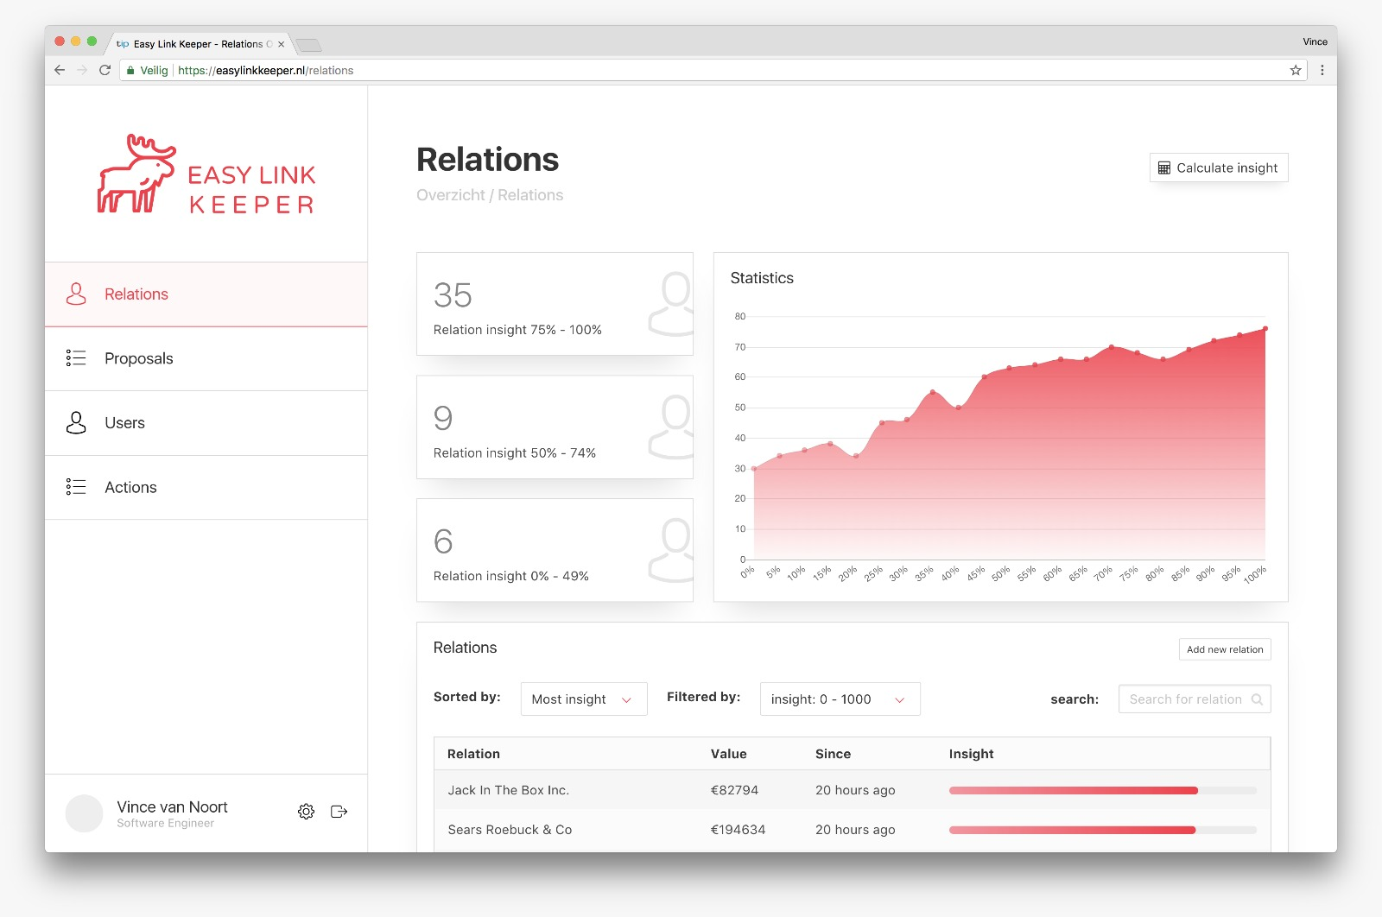
01. A small look into the design
02. Creating a relation
03. Creating a proposal
04. Editing details
Demo time
A look into how it all works
We’re going to show you how it is to work with our application by adding some information into the application. We hope that this peaks your interest into our application.

